Slide 1

Haptic Horizon
Sean Balbale, Johanna Woldeher, Crystal Kim, Donovan Chang
3/18/24

Slide 2
Table of contents
01
02
03
04
05
Introduction
Proposal Statement and Methodology
Summary and Conclusion
References
Q&A

Slide 3
01
Introduction

Slide 4
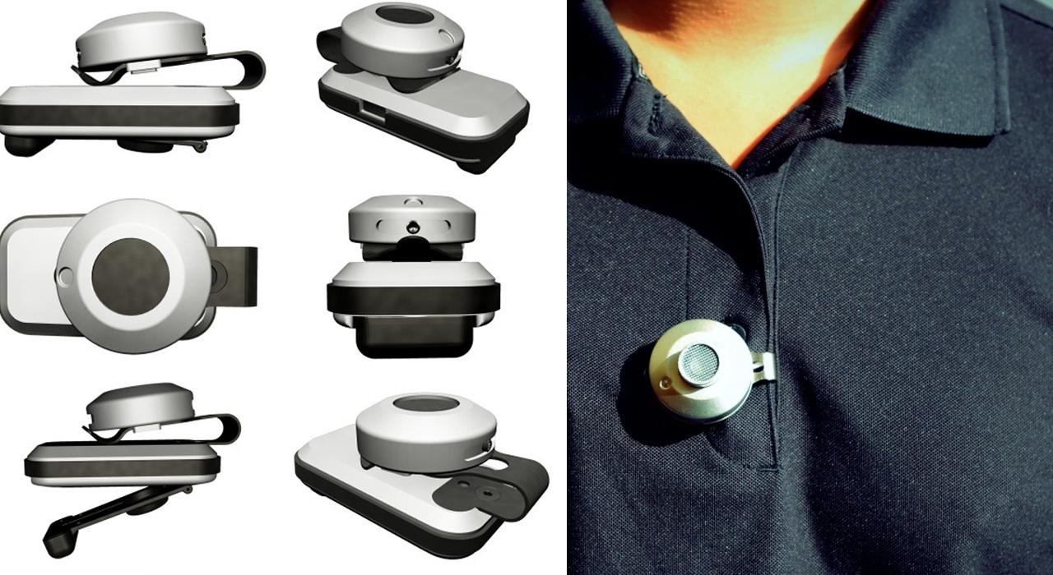
Introduction - Addressing the Needs of the Visually Impaired
Aims
Current Options
Examples
Introduce a wearable haptic alarm system tailored for the visually impaired, aiming to provide intuitive alerts for obstacle detection and assistance.
Electronic mobility aids and white canes, have drawbacks in terms of portability and user-friendliness.
BuzzClip, which employs ultrasound obstacle detection but lacks hands-free operation.
[1] Linkin to YouTube video on how to use the Buzzclip
[2] Image of Buzzclip
Notes:
Johanna
Our project introduces a wearable haptic alarm system tailored for the visually impaired, aiming to provide intuitive alerts for obstacle detection and navigation assistance.
Current options, such as electronic mobility aids and white canes, have drawbacks in terms of portability and user-friendliness.
Examples of existing devices include the BuzzClip, which employs ultrasound for obstacle detection but lacks hands-free operation.

Slide 5
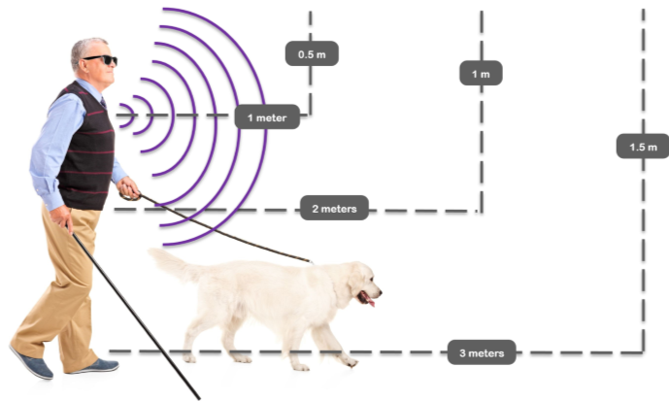
Background and Core Idea
Background
Core Idea
Physical resources
Limitations of current solutions and the need for innovation.
Introduce our creative design prioritizing portability, user-friendliness, and hands-free operation.
Departure from reliance on auditory cues in favor of haptic vibrations for real-time feedback.
[3] Image Shows Auditory Cues with Device.
Notes:
crystal
Background: Discuss limitations of current solutions and the need for innovation.
Core Idea: Introduce our creative design prioritizing portability, user-friendliness, and hands-free operation.
Mention the departure from reliance on auditory cues in favor of haptic vibrations for real-time feedback.

Slide 6
02
Proposal Statement and Methodology

Slide 7
Proposal-Introducing the Wearable Haptic Alarm System
Our wearable haptic alarm system aims to provide intuitive alerts for obstacle detection and navigation assistance to the visually impaired.
Utilizing haptic vibrations delivered through a lanyard-hung device for hands-free operation.
Methodology: Utilizing ultrasonic sensors, Arduino, motors, and 3D printed mounts from the SparkFun kit for construction.
Notes:
Donovan
Our wearable haptic alarm system aims to provide intuitive alerts for obstacle detection and navigation assistance to the visually impaired.
Utilizing haptic vibrations delivered through a lanyard-hung device for hands-free operation.
Methodology: Utilizing ultrasonic sensors, Arduino, motors, and 3D printed mounts from the SparkFun kit for construction.

Slide 8
Technology Overview
Components
Construction
Feedback Mechanism
Ultrasonic sensors
Arduino
Motors (sparkfun)
Breadboard (sparkfun)
Haptic vibrations with varying intensity or patterns indicate the presence of obstacles
Use of 3D printed mounts for assembling the wearable device.
Notes:
sean
Components: Detail the use of ultrasonic sensors, Arduino, motors, and breadboard from the SparkFun kit.
Feedback Mechanism: Explain how haptic vibrations with varying intensity or patterns indicate the presence of obstacles.
Construction: Describe the use of 3D printed mounts for assembling the wearable device.

Slide 9
03
Summary and Conclusion

Slide 10
Summary of Project
Summary
Importance
Safety and Independence
The development of the wearable haptic alarm system and its core features.
Significance of hands-free navigation assistance for the visually impaired.
Improvement in safety and independence for users.
Notes:
Summary: Recap the development of the wearable haptic alarm system and its core features.
Importance: Emphasize the significance of hands-free navigation assistance for the visually impaired.
Mention the improvement in safety and independence for users.

Slide 11
Conclusion
Conclusions
Impact
Future Directions
Creation of a wearable haptic lanyard for obstacle detection.
Enabling blind individuals to be hands-free and independent in their daily activities.
Potential enhancements and applications of the technology.
Notes:
Conclusion: Reiterate the creation of a wearable haptic lanyard for obstacle detection.
Impact: Stress the importance of enabling blind individuals to be hands-free and independent in their daily activities.
Future Directions: Discuss potential enhancements and applications of the technology.

Slide 12
References
[1] All Access Life, “Buzzclip Review - New Tech for the blind,” YouTube, https://www.youtube.com/watch?v=RPyQd-Wnq-8 (accessed Mar. 20, 2024).
[2] Image of Buzzclip.
[3] A. Lamba, Photo Gallery of IMerciv BuzzClip Wearable Mobility Aid For The Blind And Low Vision.

